Slide 1
BEE PATH in Ljubljana
Maruška Markovčič

Slide 2
Established in 2015 within he Green Capital of Europe 2016
It conects two strategical development lines – biodiversity and food self-suficency
Bee Path is:
An actual path between the points
Movement for the benefit of the bees
it is based on a tradition and builds for the future
Till now it has 35 partners

Slide 3
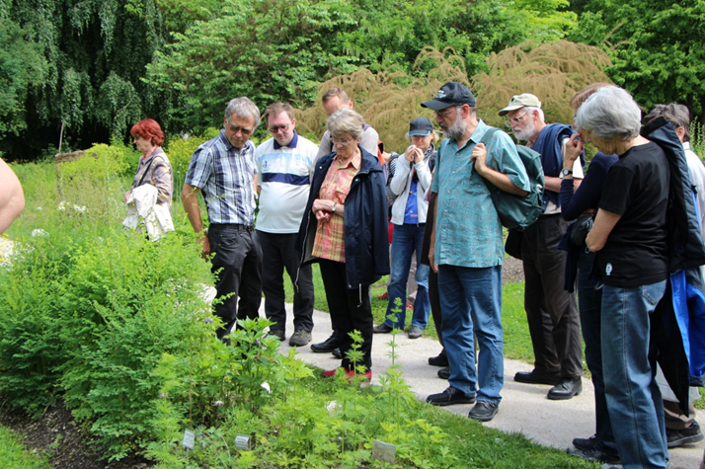
GOALS
Enlargement and development of beekeeping in City of Ljubljana(education, entreperneurship, supplementary activities, co-finncing of beekeepers associations)
Urban beekeeping (safety, awarenes, education of the citizens, regulations…)
New products:
Tourism program
Educational programs for kindergarten and primary school children
New forms of urban apiaries

Slide 5
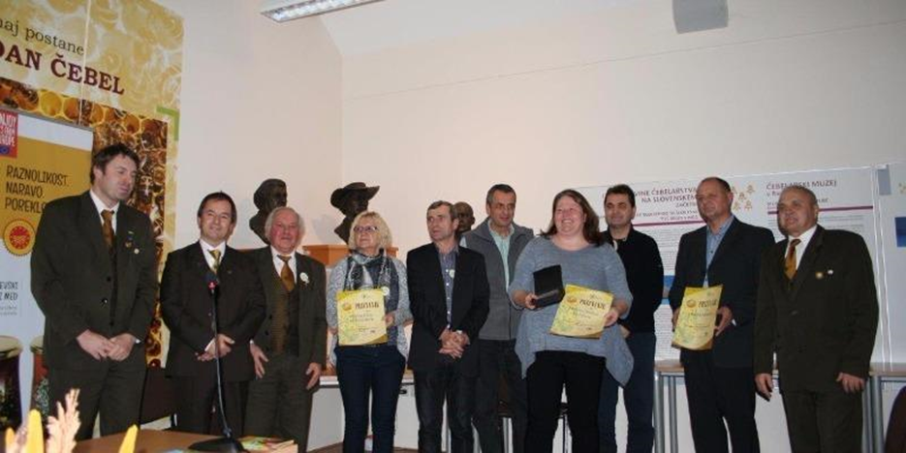
City of Ljubljana – 2017 most friendly municipality to the bees in Slovenia

Slide 6
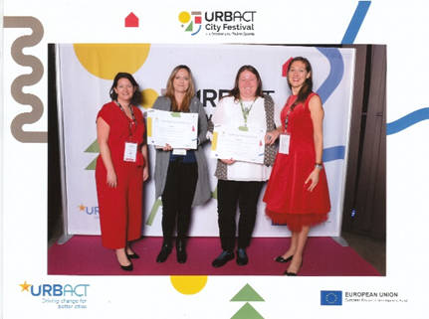
URBACT best practice in 2017
BeePathNet

Slide 7
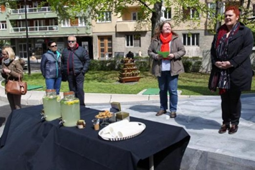
Meliferous pants
BTC – Lets help the bee in the city: plant flowers
Distribution of flower seeds
Flower fair
Photographic exhibition
Gardens with meliferous plants
City plants meliferous plants on public areas
Educational programs in Botanical garden

Slide 8
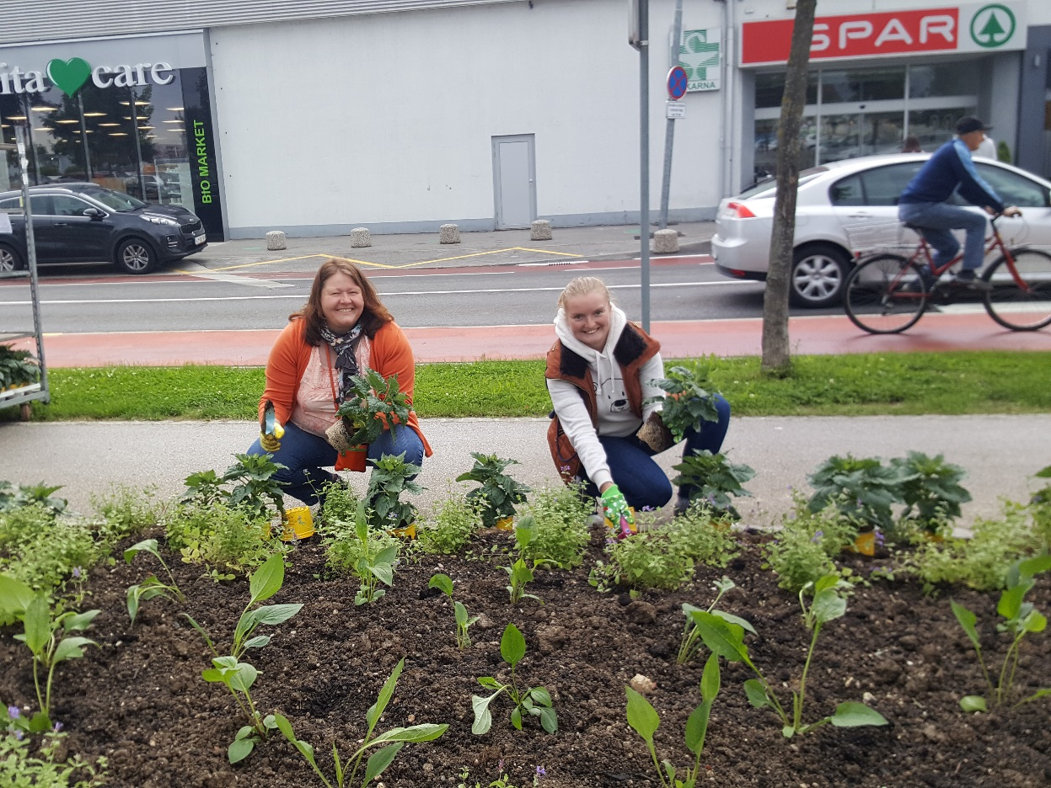
Planting sonflowers with children from ecoschools

Slide 9
Meliferous garden and Apiary kindergarten

Slide 10
Awarenes raising
Urban bee homes from Plečnik till today

Slide 11
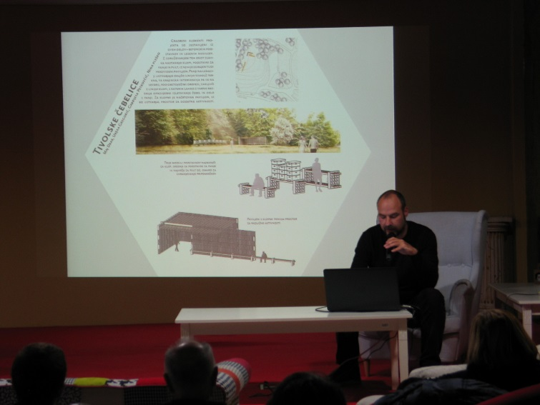
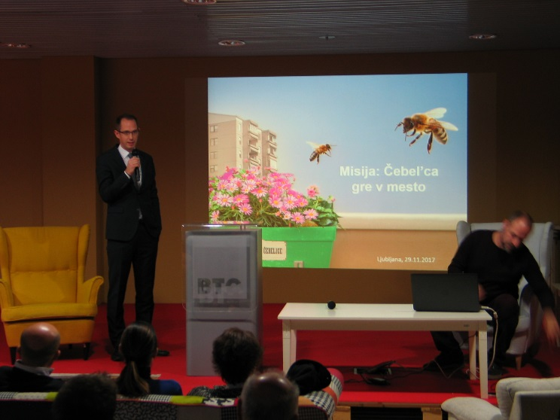
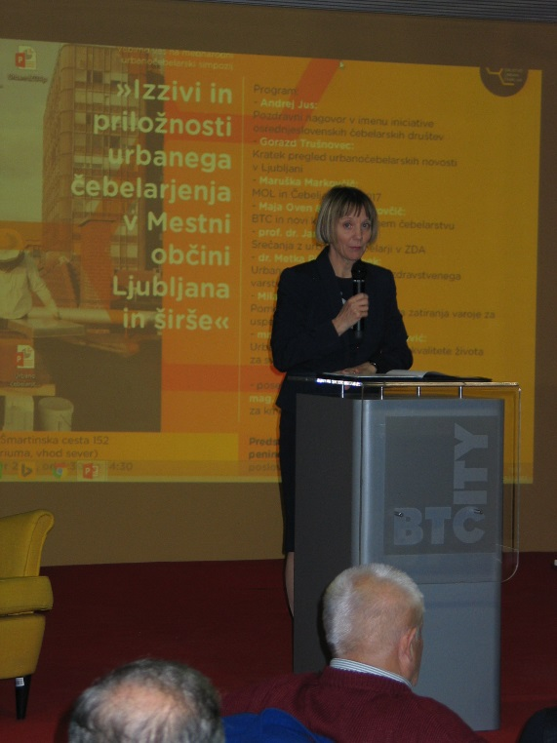
Chalenges and oportunities of urban beekeeping - symposium

Slide 12
Photographical exhibition of urban beekeeping

Slide 13
New products
Urban bee stands and be houses
Medul
Stojišča v Tivoliju

Slide 14
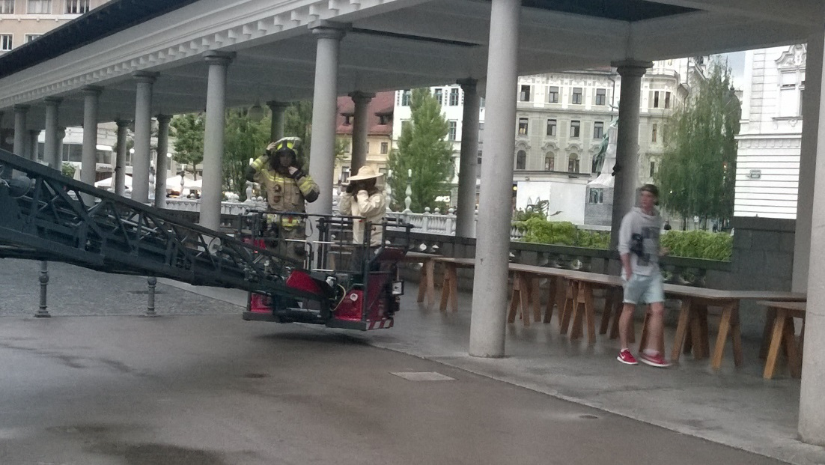
Regulations
Swarm colecting group
SOS line
Rok Čemažar
Iztok Holz
Robert Kovačič
Jan Krizstan
Trajče Nikoloski
Peter Pečenko
Gorazd Trušnovec

Slide 15
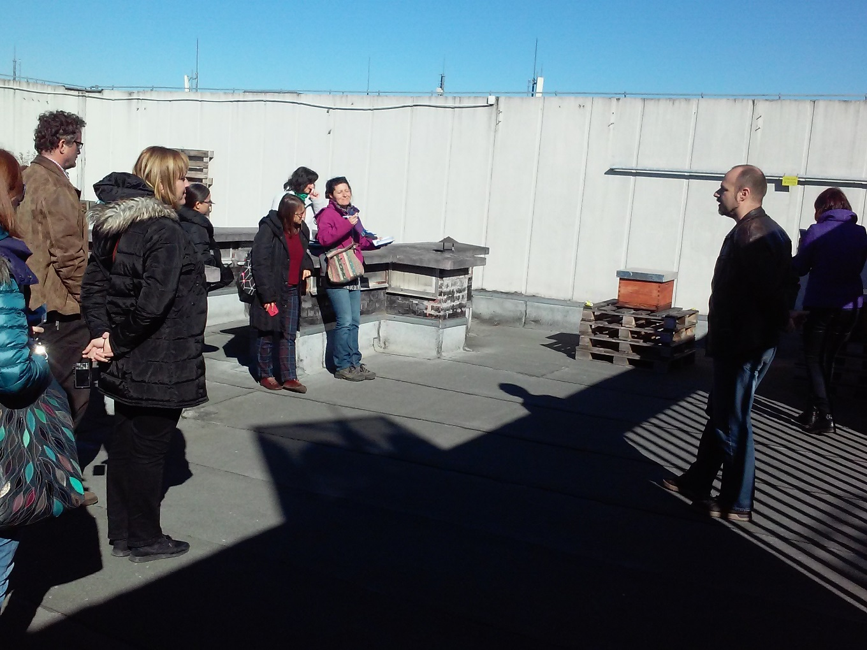
Education and tourism
Education of tourist guides

Slide 16
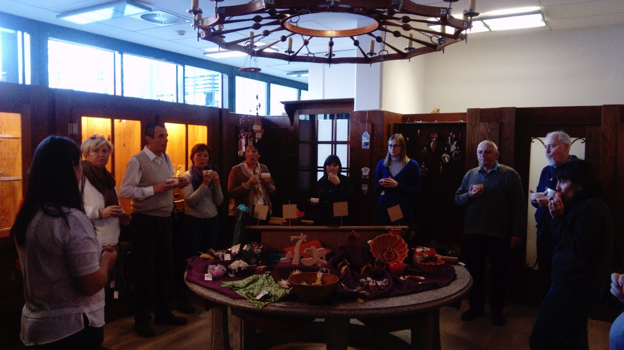
Education and tourism
Slovene Ethnographical Musem – Honey experience

Slide 17
Education and tourism
Educational Bee-house of Beekeepers associaition Barje
Highschool students

Slide 18
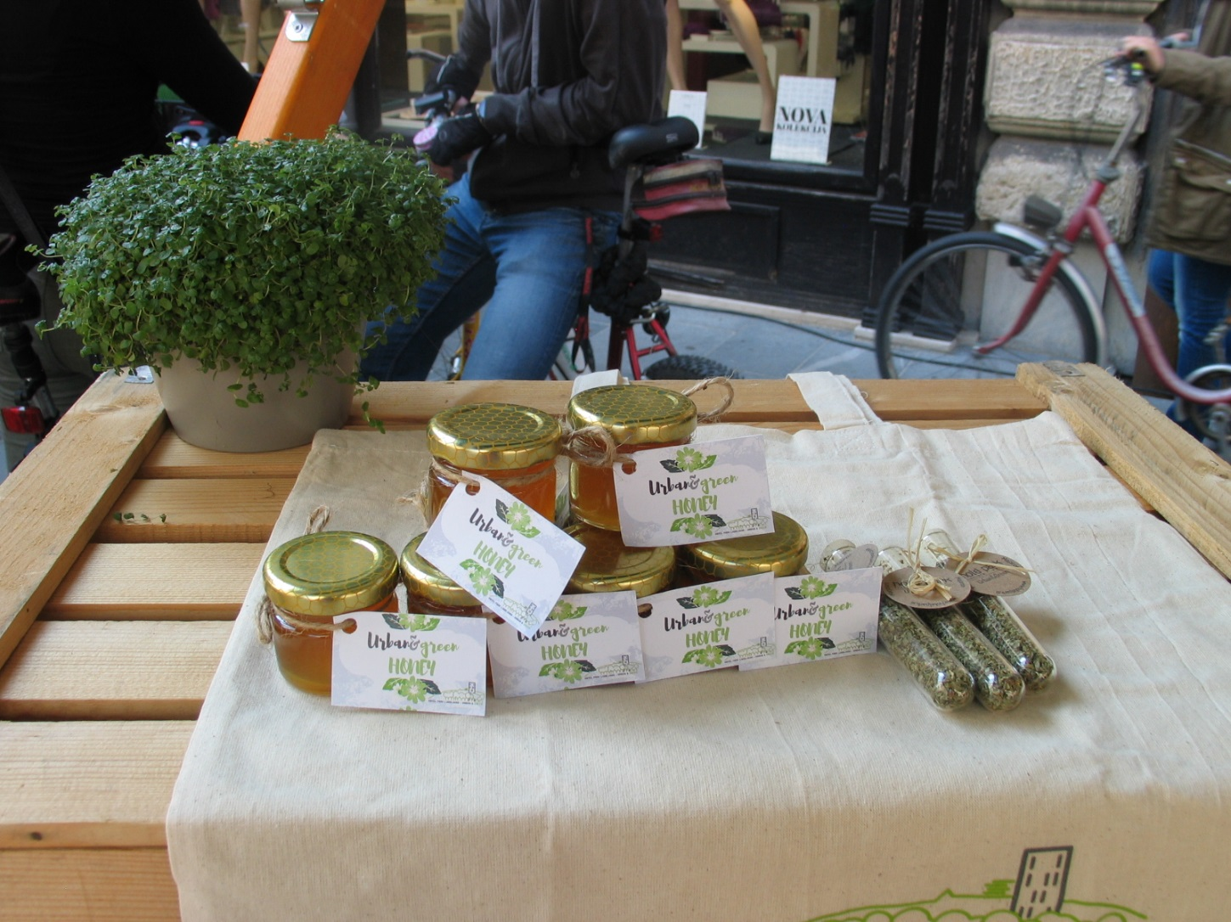
Honey day
Promotion

Slide 19
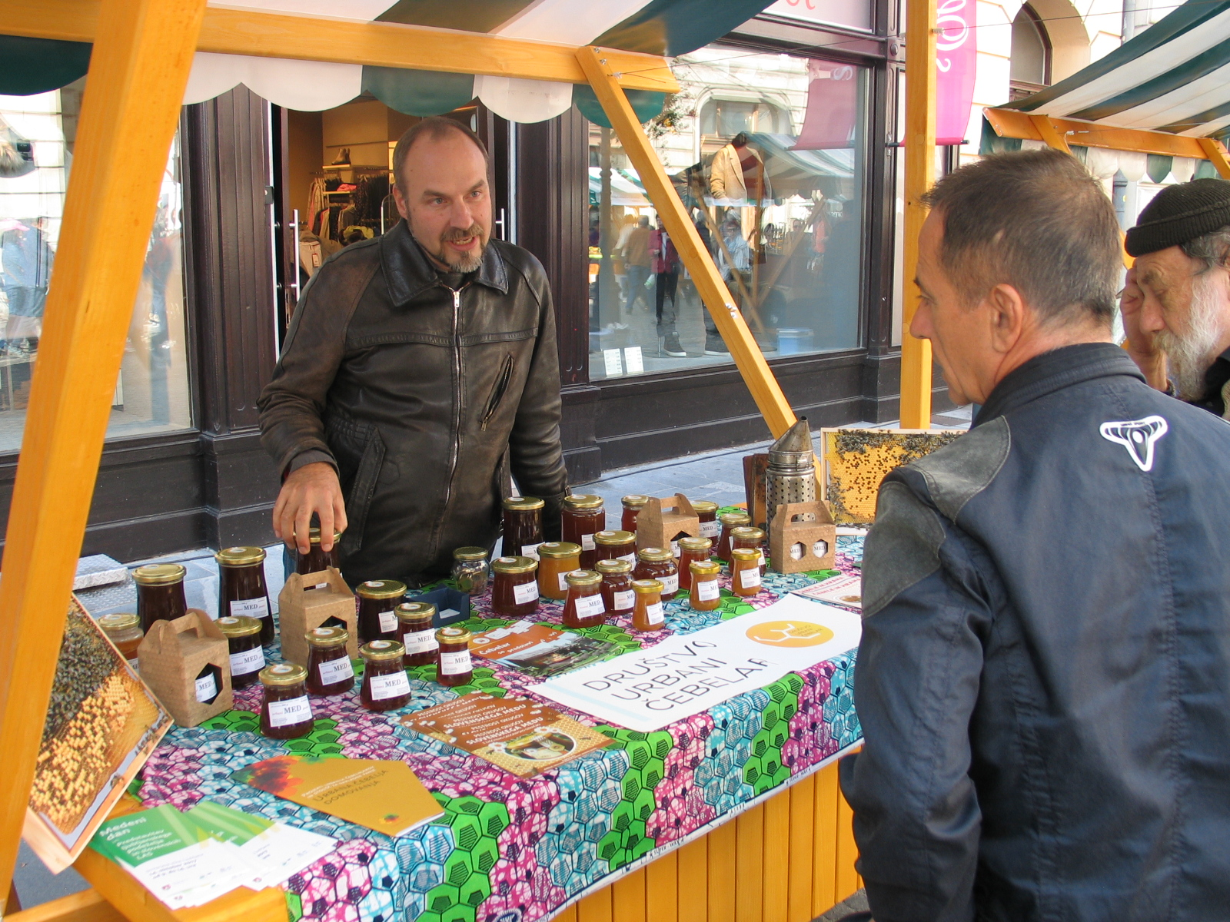

Slide 24
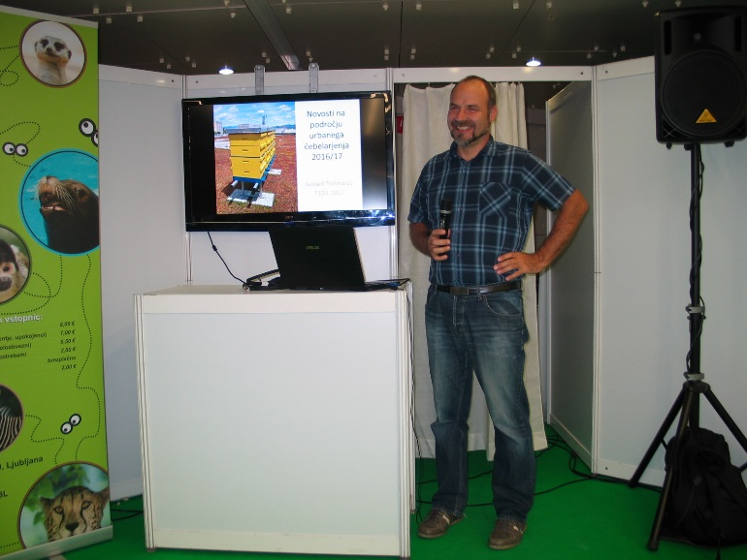
Festival for third life period

Slide 25
New members
SKB
A1 – Flovering Slovenska cesta

Slide 26
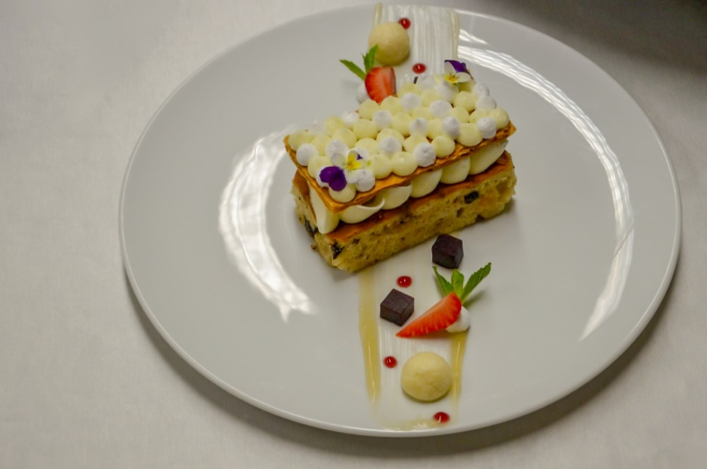
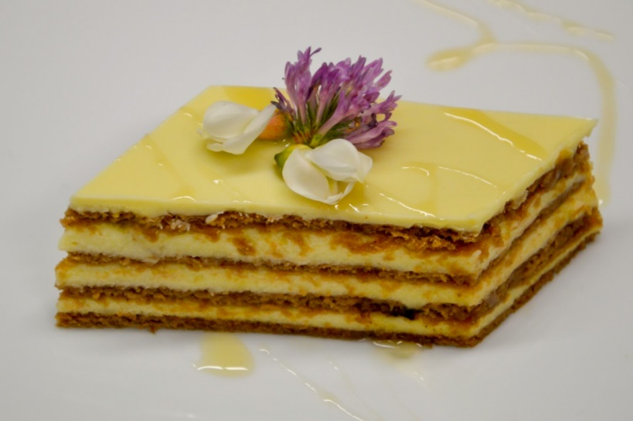
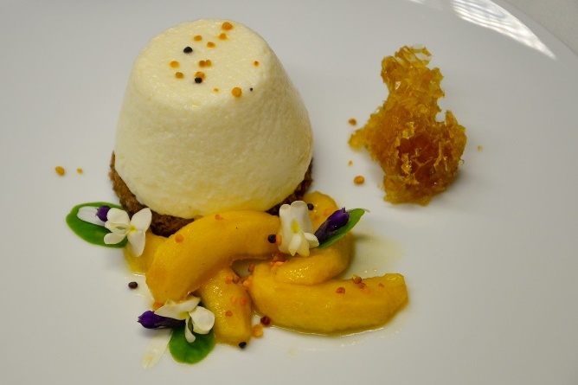
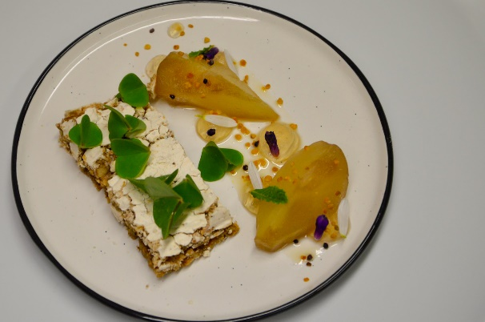
Gostilna pri Kolovratu

Slide 27
https://www.ljubljana.si/sl/moja-ljubljana/podezelje/cebelja-pot/

